Slide 1
Lecture 3
Linear Wire Antennas

Slide 2
Application of the radiation equation to an electrically-small dipole
Electrically-short dipole
Far field and near field definition
Finite-length dipole
Derivation of effective area

Slide 3
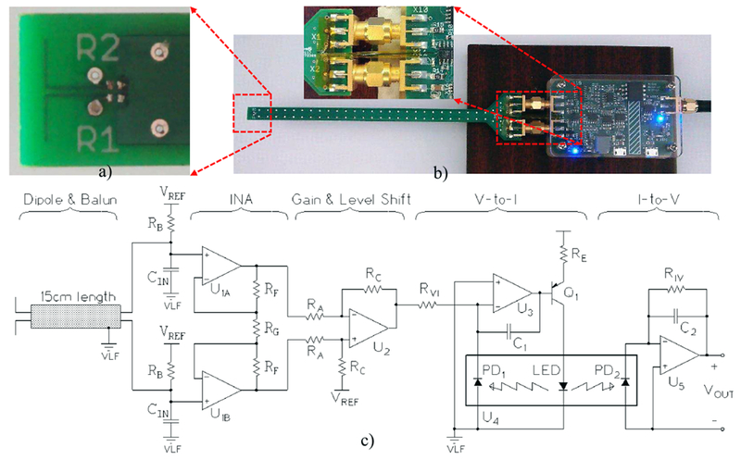
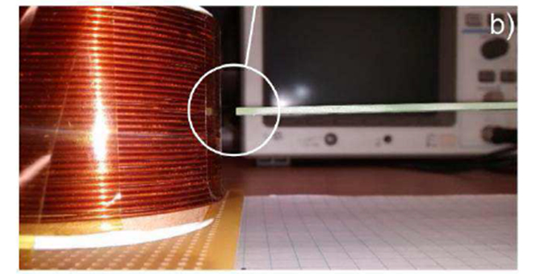
Electrically-Small Dipole
5mm
electrically small dipole antenna probe for the measurement of electric field distributions over the frequency band from 100 Hz to 300 kHz
Zolj, Adnan et al. “Electrically Small Dipole Antenna Probe for Quasistatic Electric Field Measurements in Transcranial Magnetic Stimulation.” IEEE transactions on magnetics vol. 55,1 (2019): 5800110. doi:10.1109/TMAG.2018.2875882

Slide 4
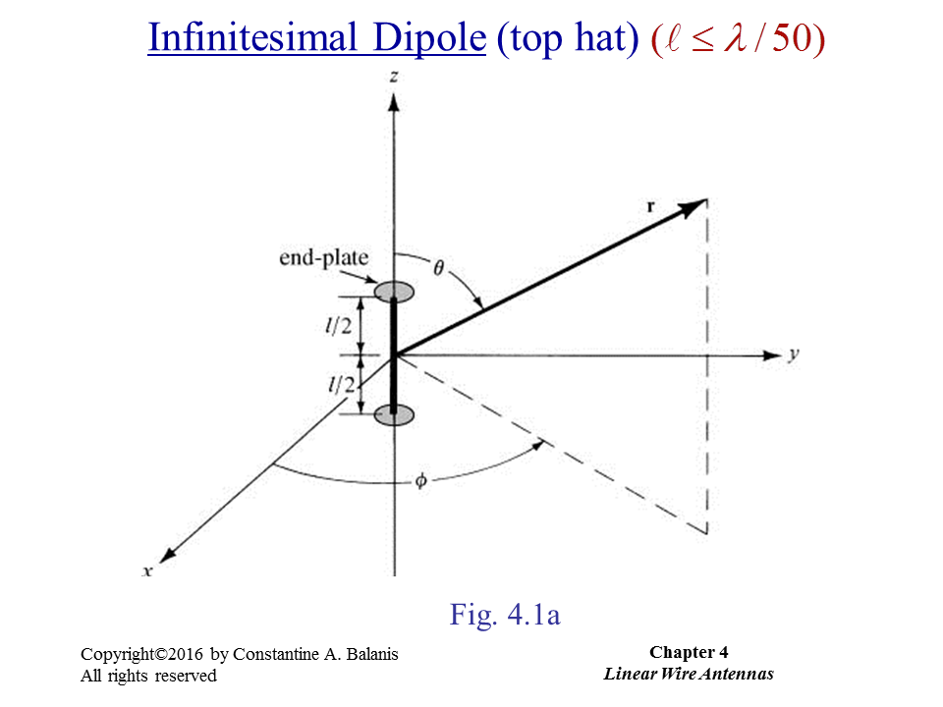

Slide 5
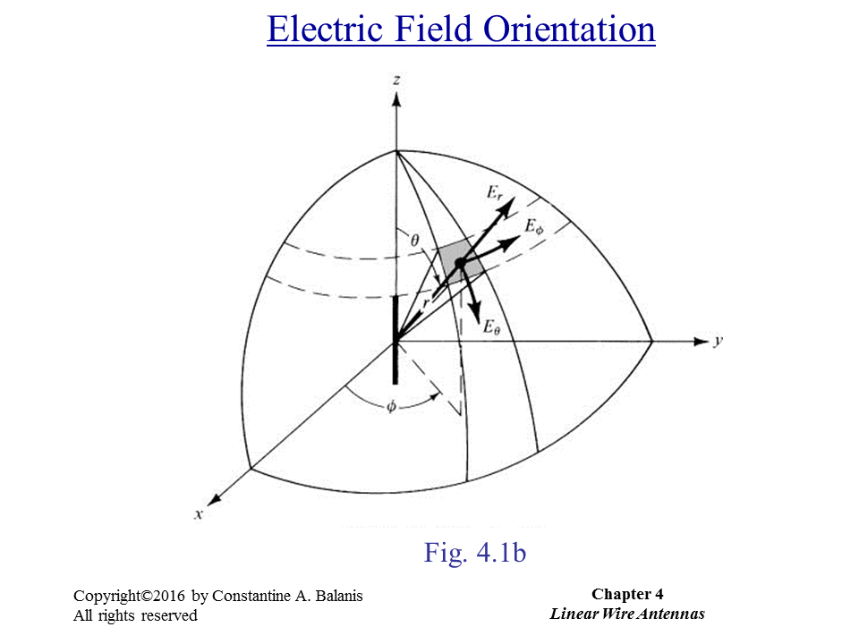

Slide 6
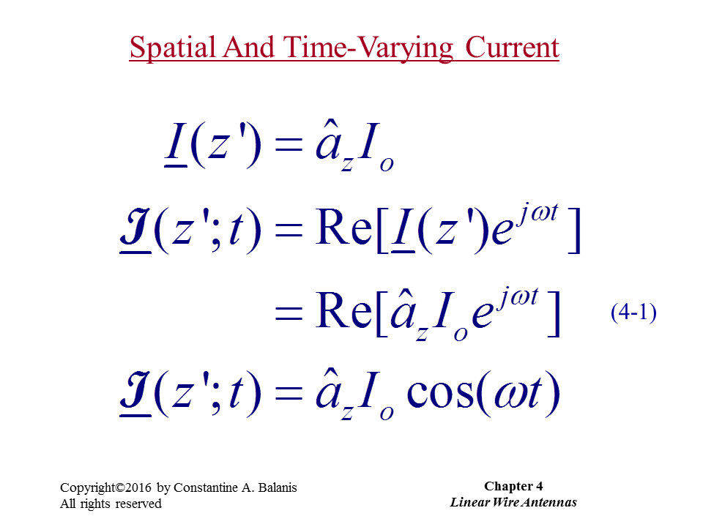

Slide 7
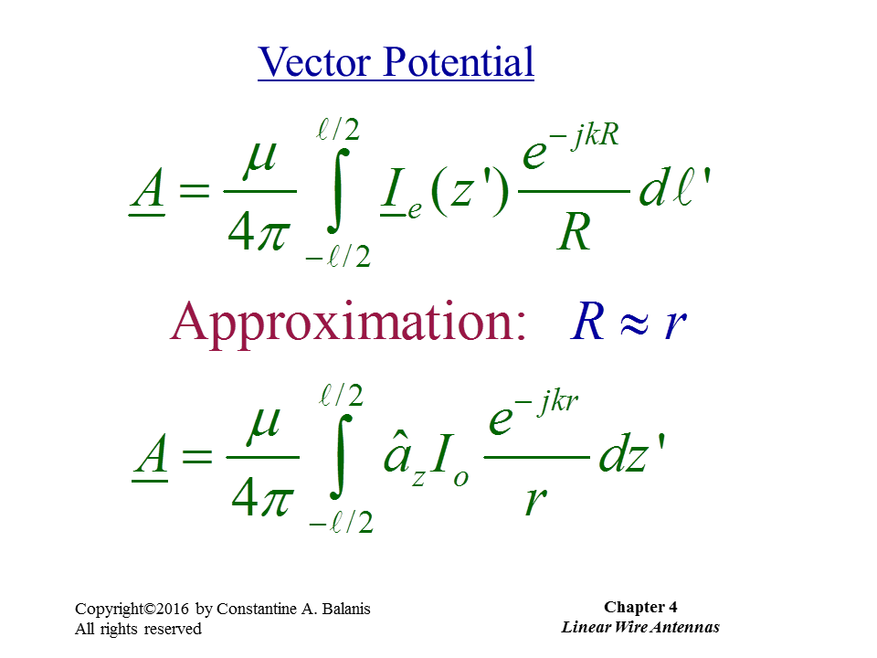

Slide 8
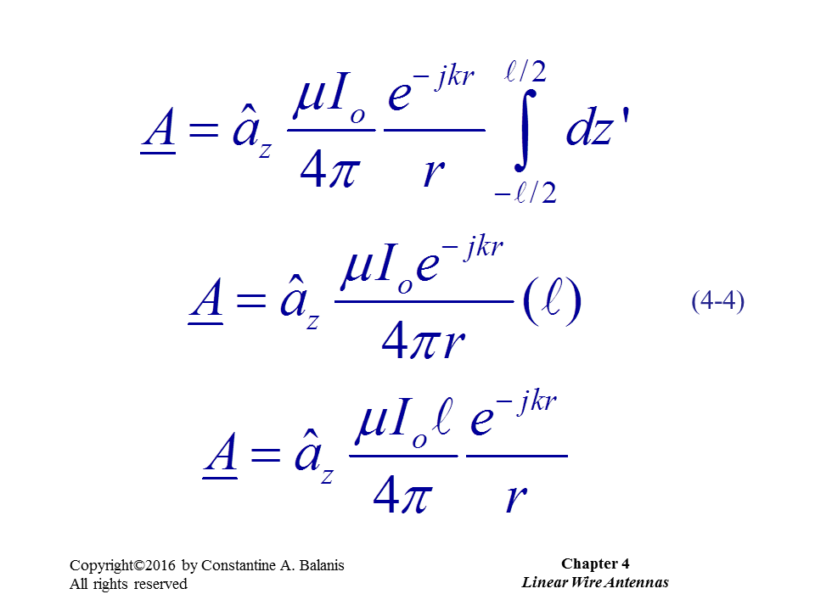

Slide 9
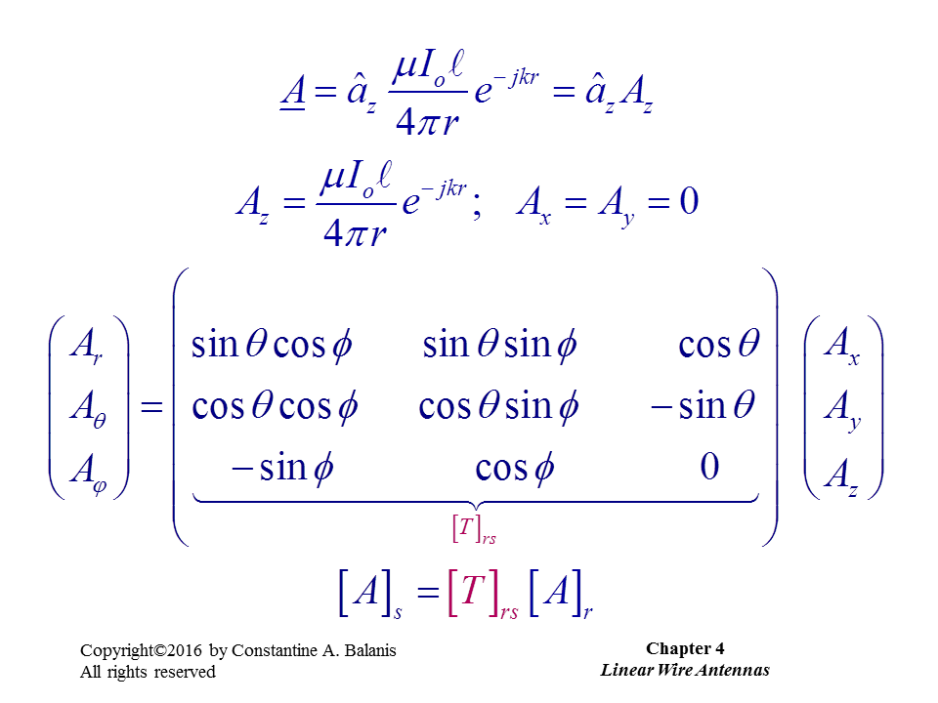

Slide 10
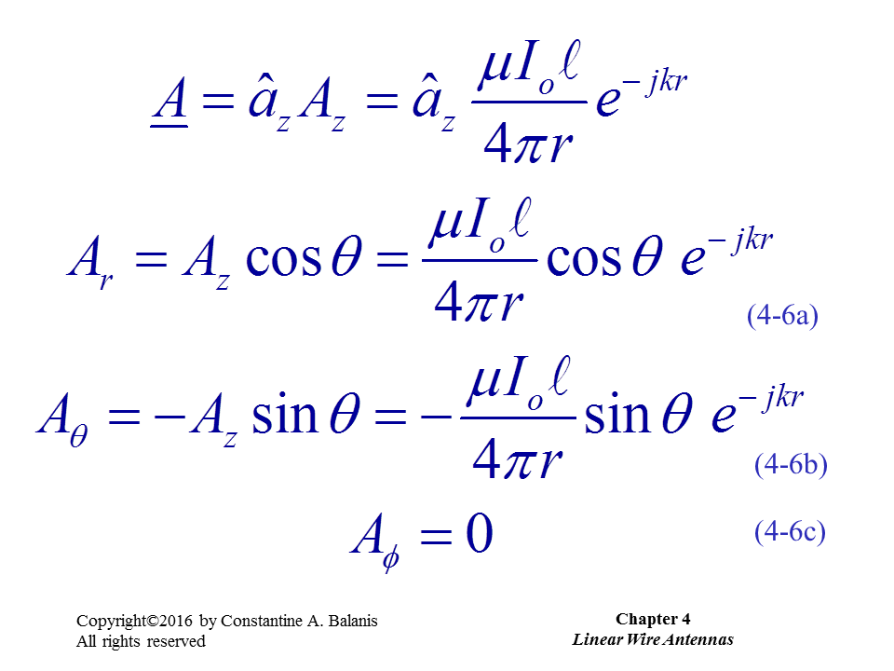

Slide 11
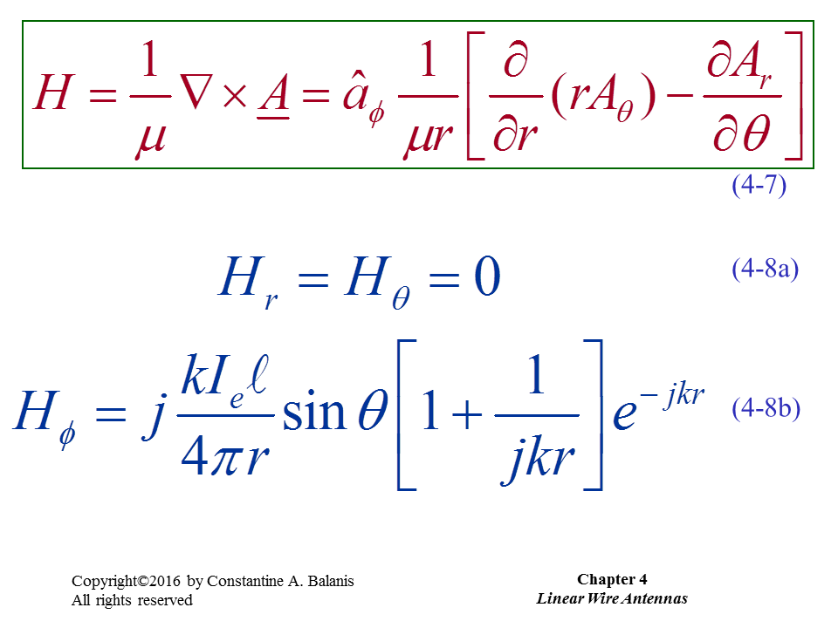

Slide 12
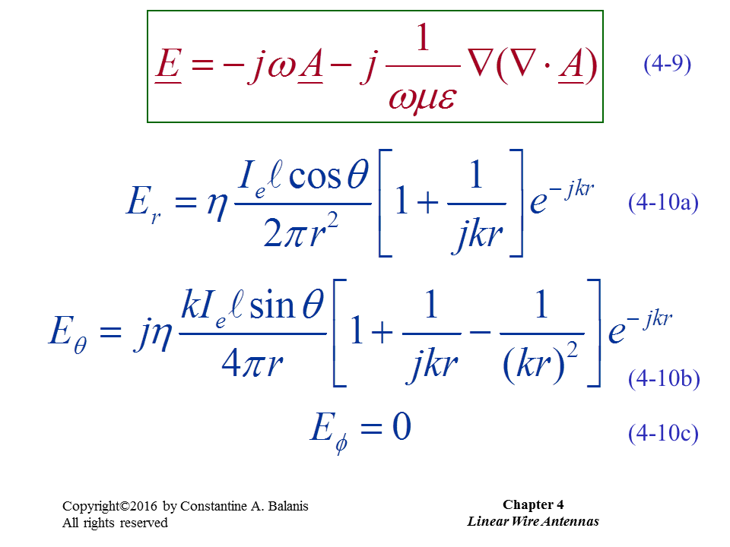

Slide 13
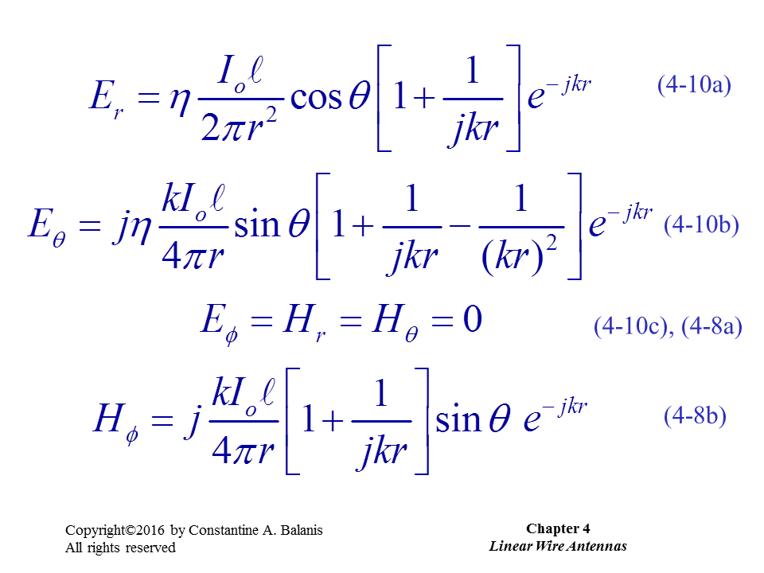
Dominating terms in the far field

Slide 14
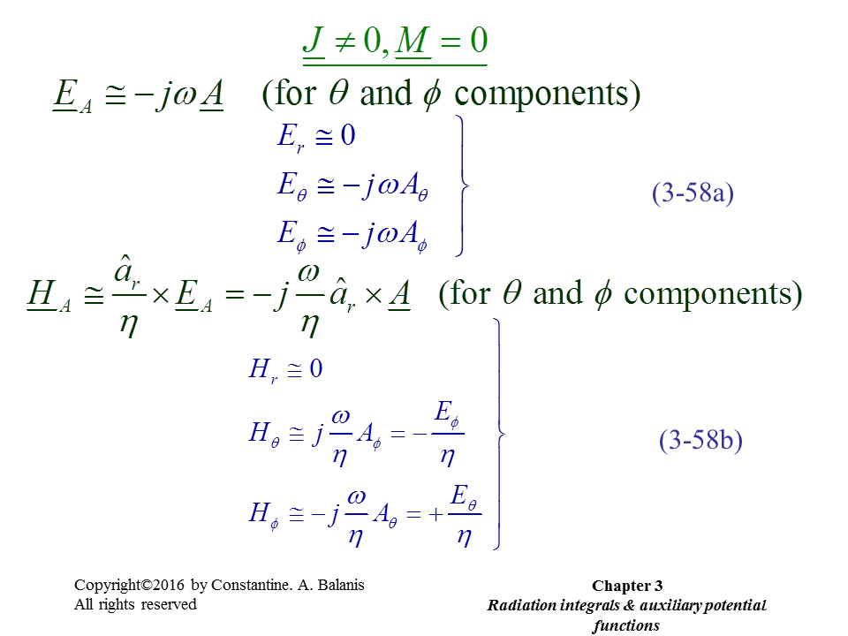
You can also use these formulas if far field is your interest.

Slide 15
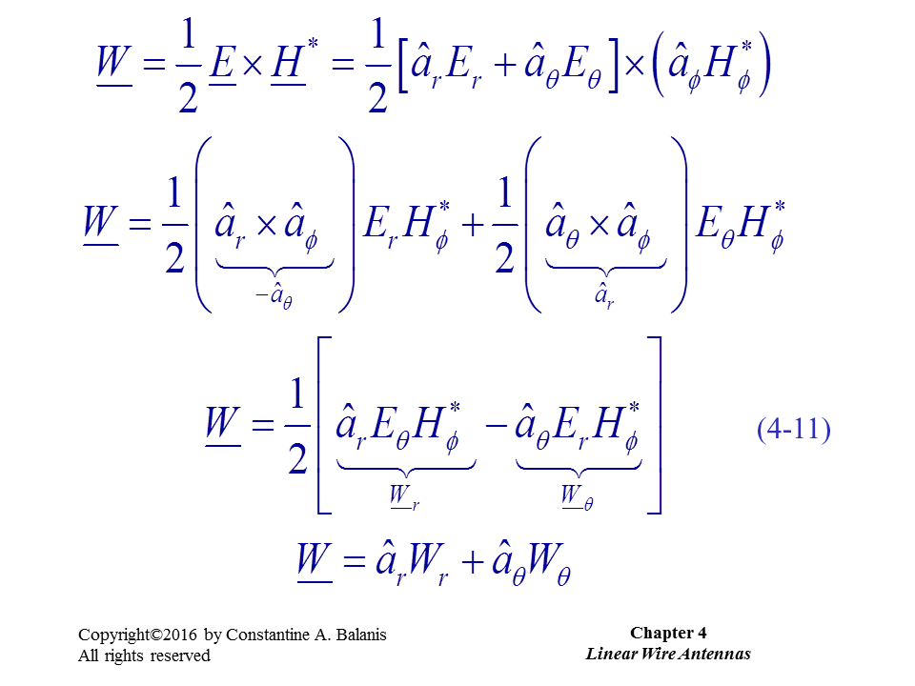

Slide 16
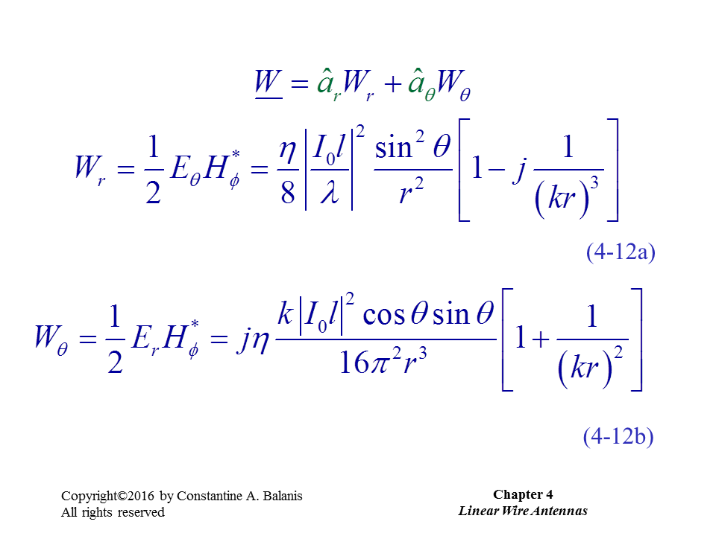
This is the power which is radiated to the far field

Slide 17
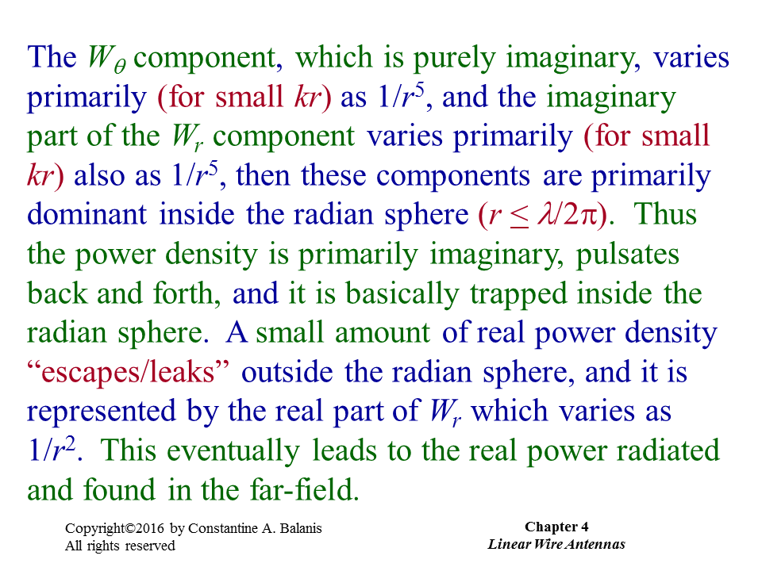

Slide 18
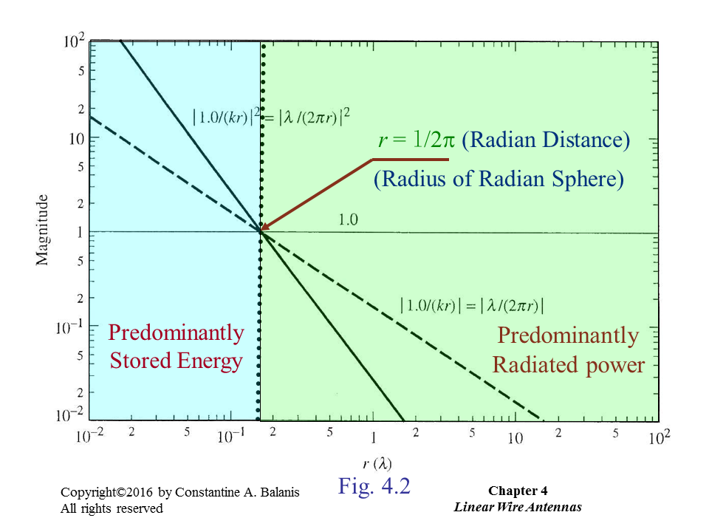

Slide 19
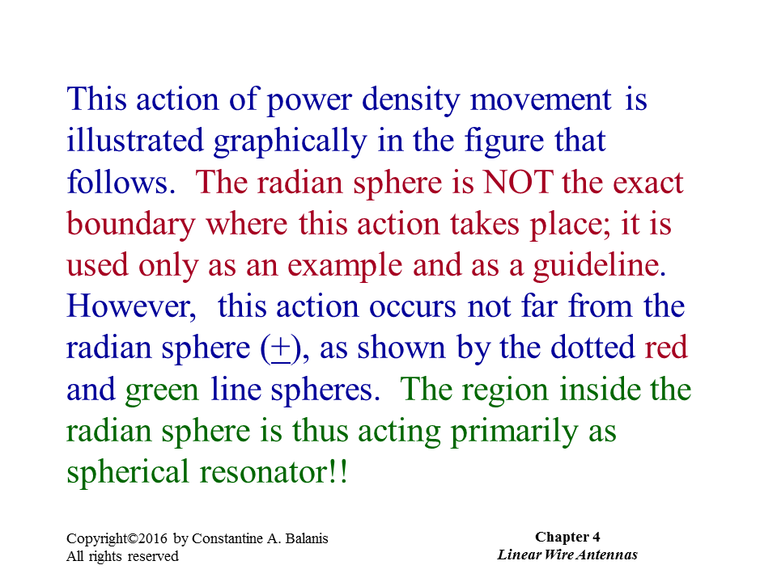

Slide 20
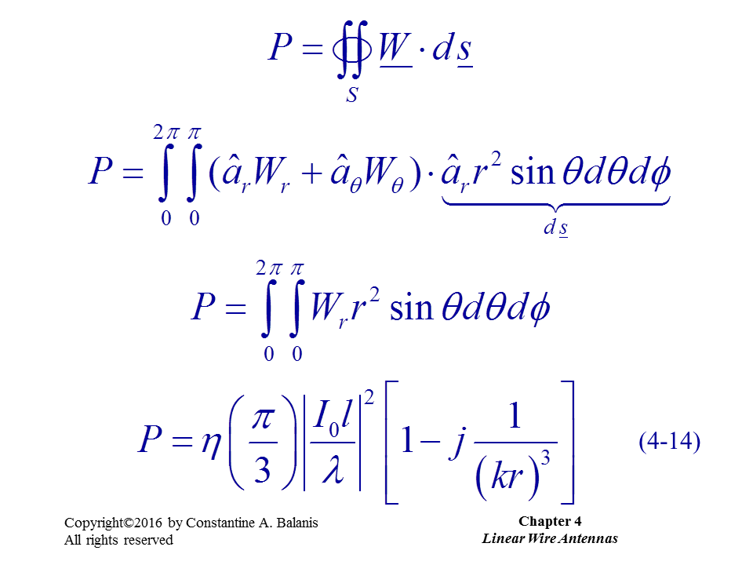

Slide 21
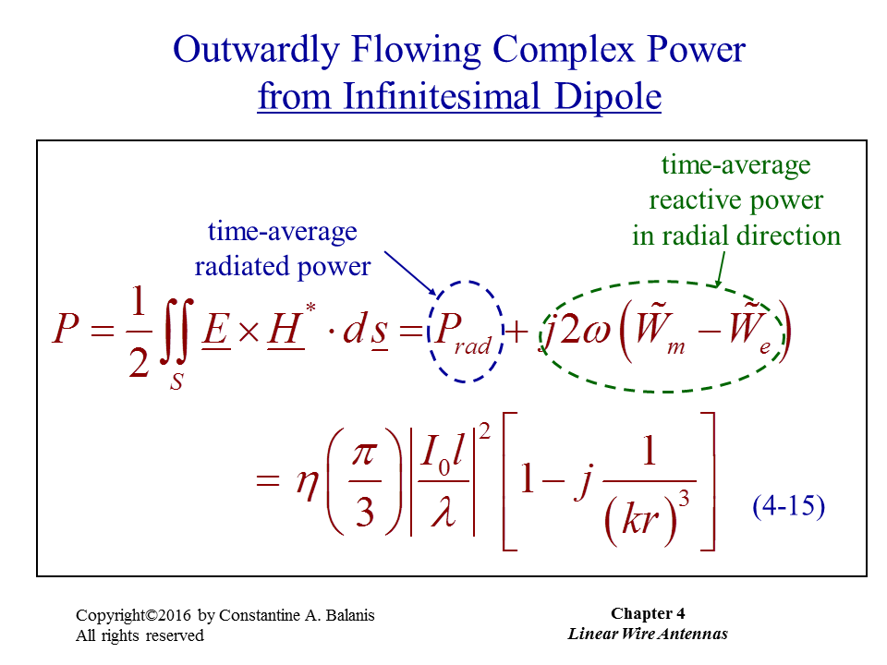

Slide 22
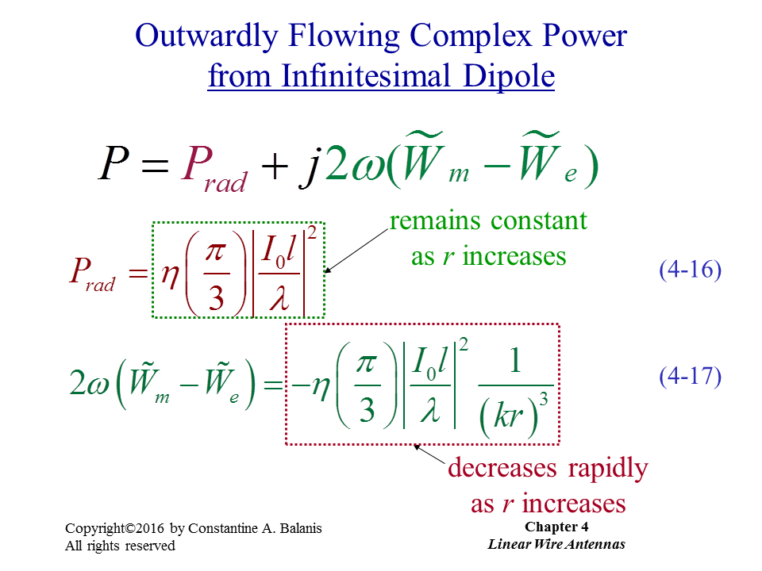

Slide 23
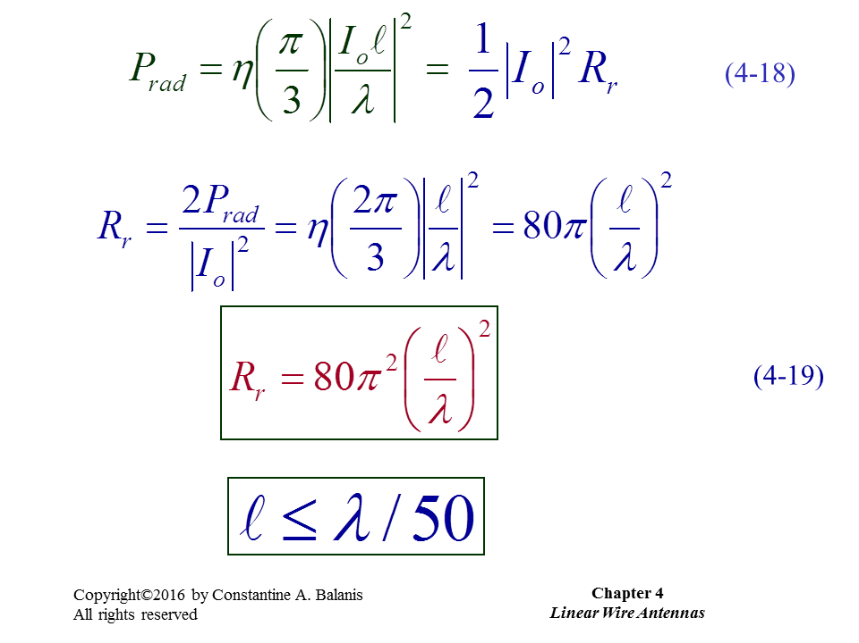

Slide 24
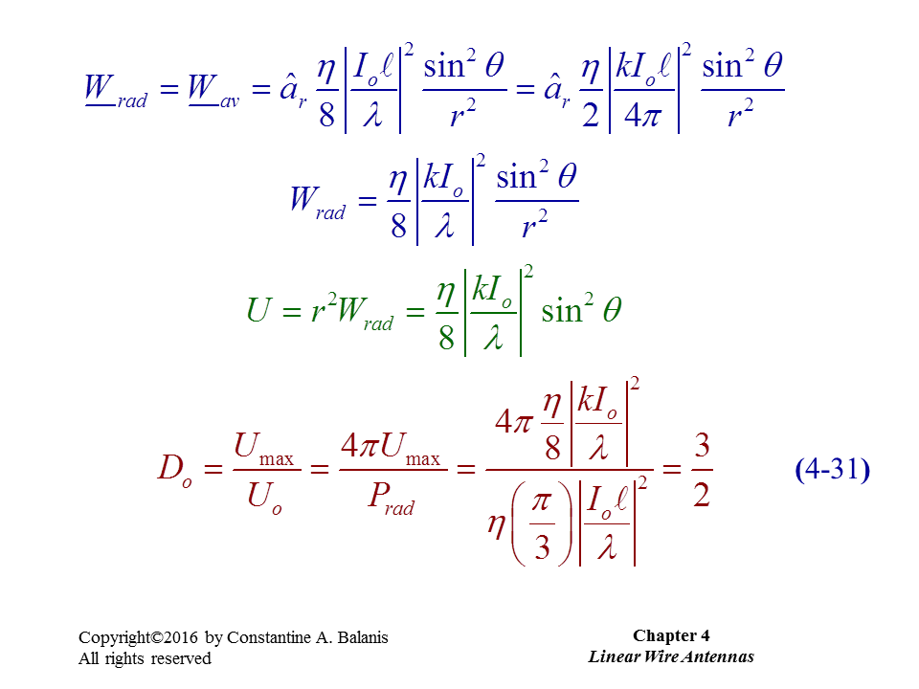

Slide 25
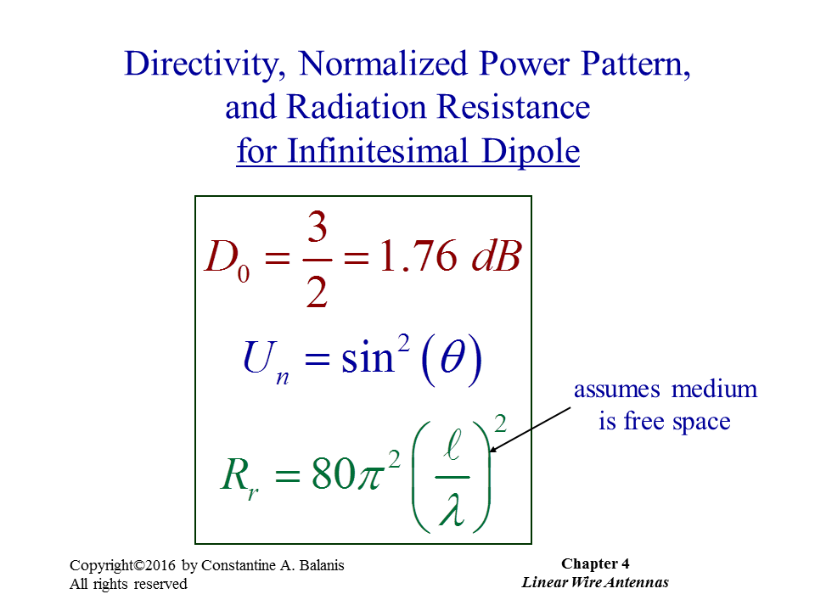

Slide 26
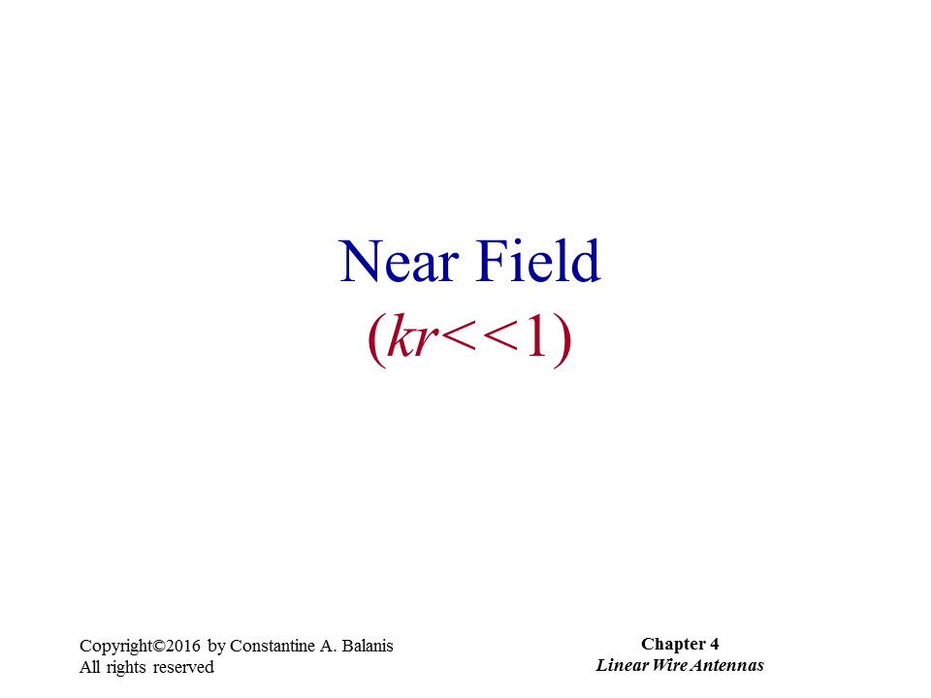

Slide 27
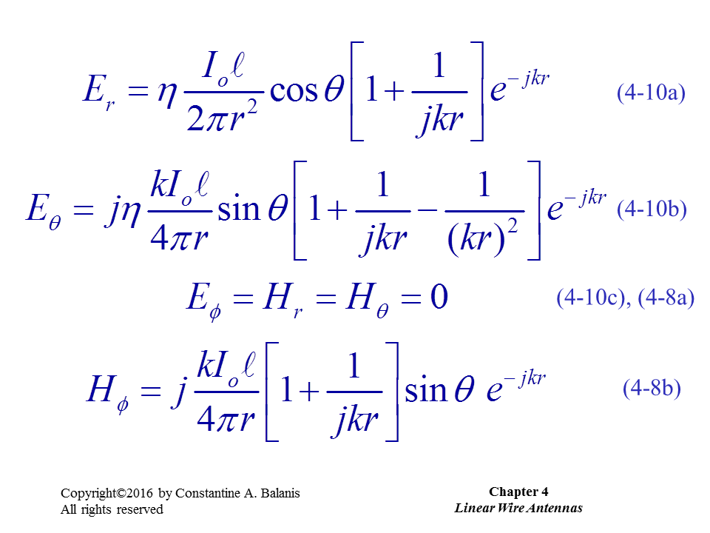

Slide 28
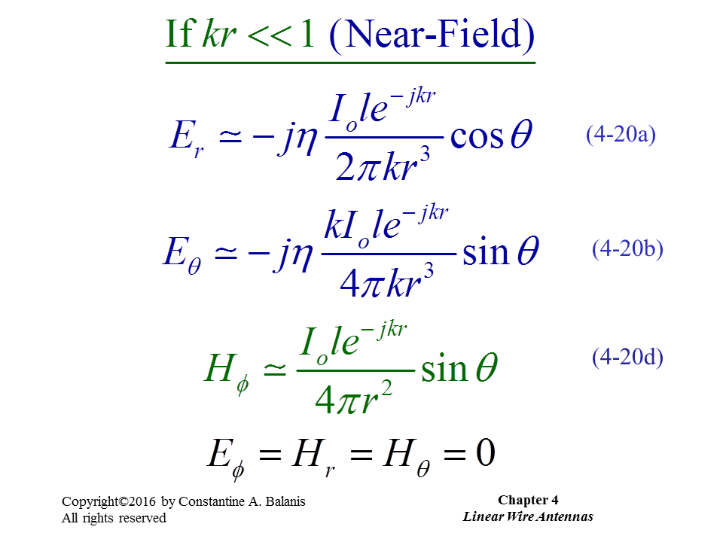

Slide 29
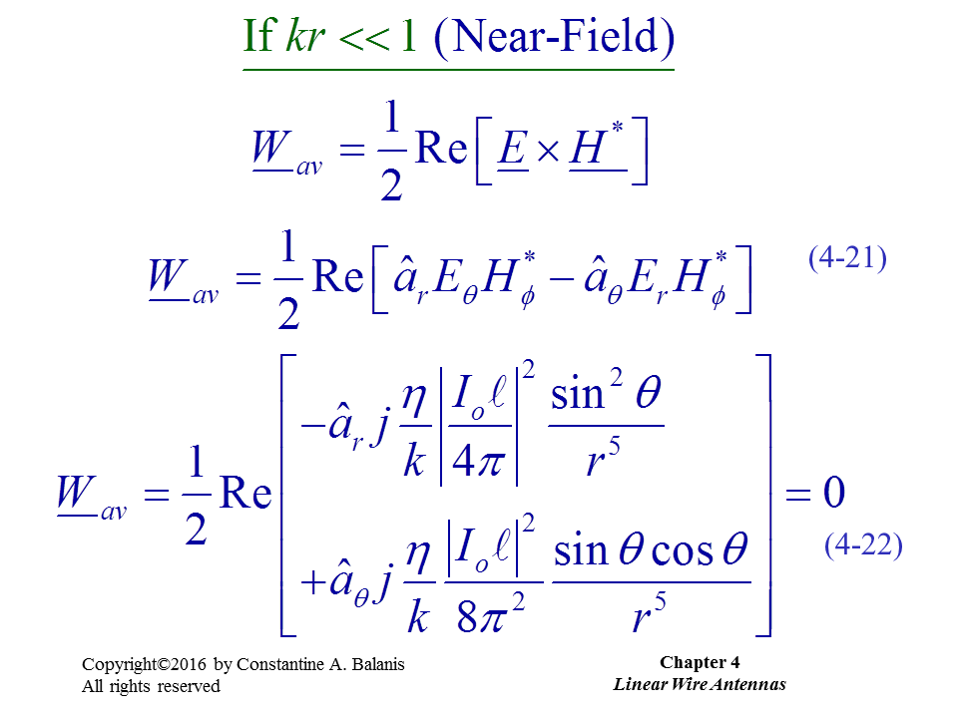

Slide 30
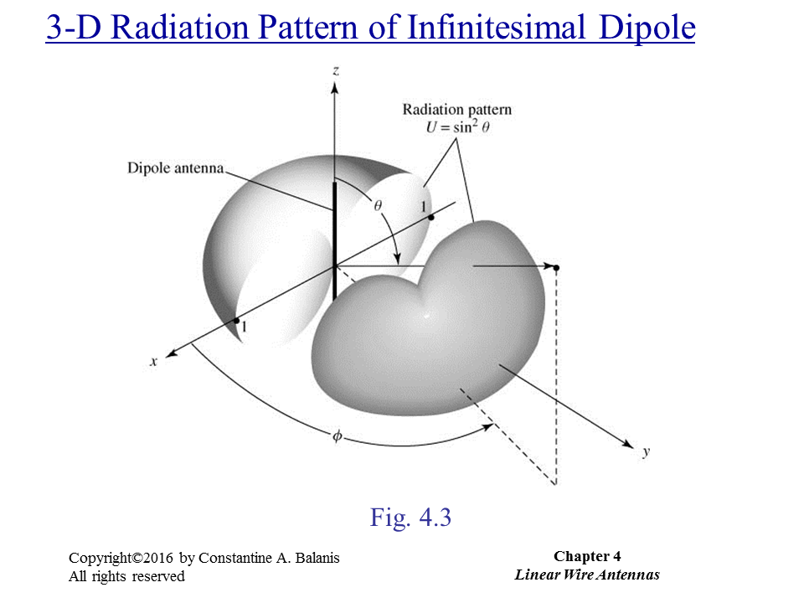

Slide 31
Electrically-Short Dipole
S. Das, D. J. Sawyer, N. Diamanti, A. P. Annan and A. K. Iyer, "A Strongly Miniaturized and Inherently Matched Folded Dipole Antenna for Narrowband Applications," in IEEE Transactions on Antennas and Propagation, vol. 68, no. 5, pp. 3377-3386, May 2020, doi: 10.1109/TAP.2019.2963232.

Slide 32
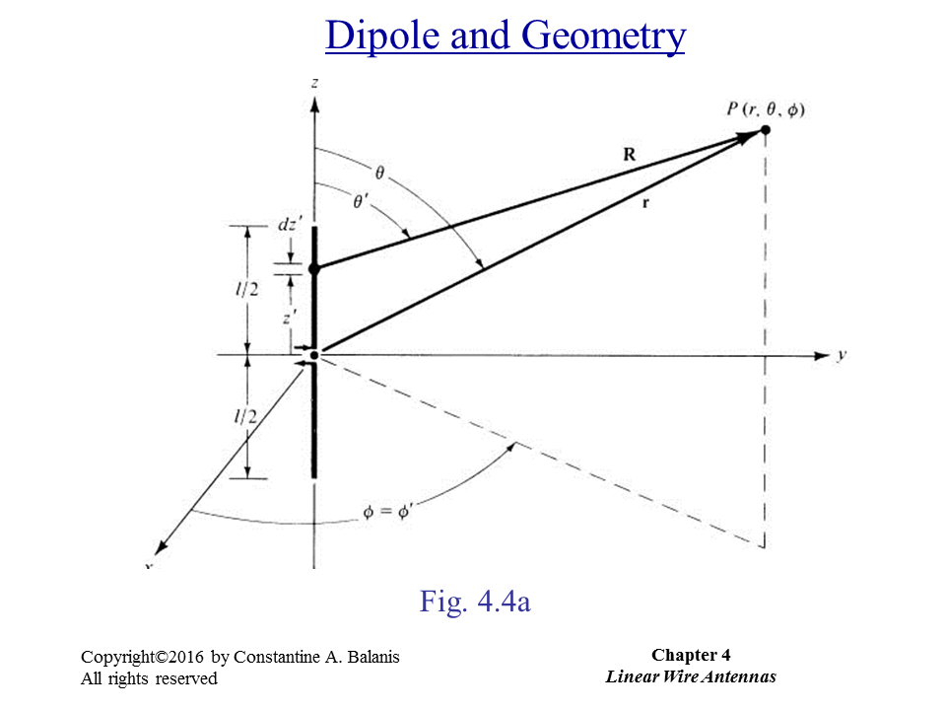

Slide 33
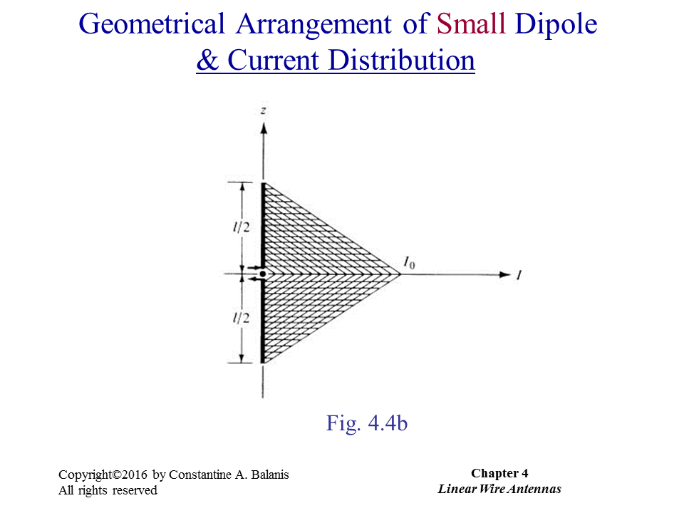

Slide 34
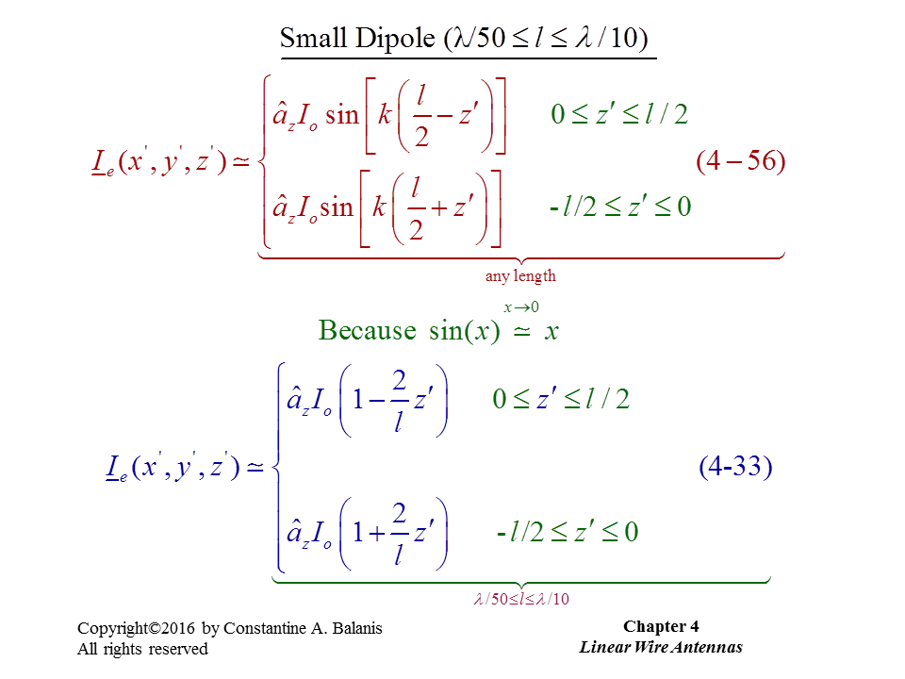

Slide 35
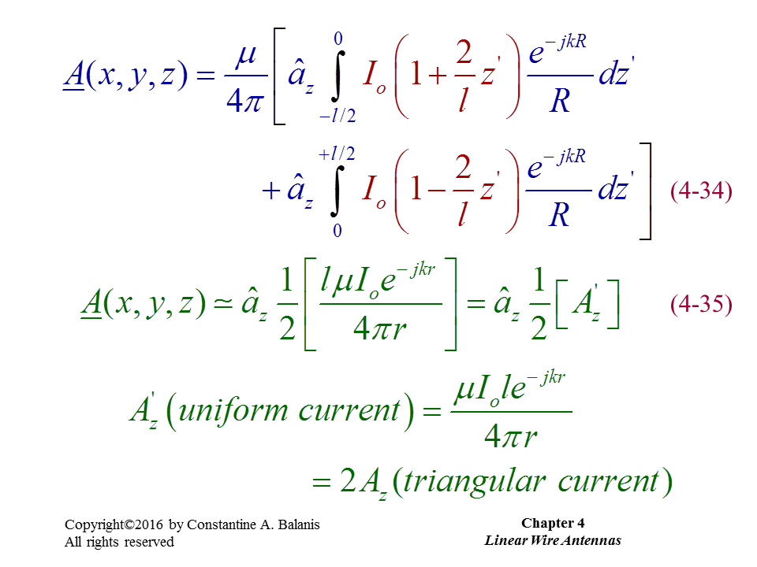

Slide 36
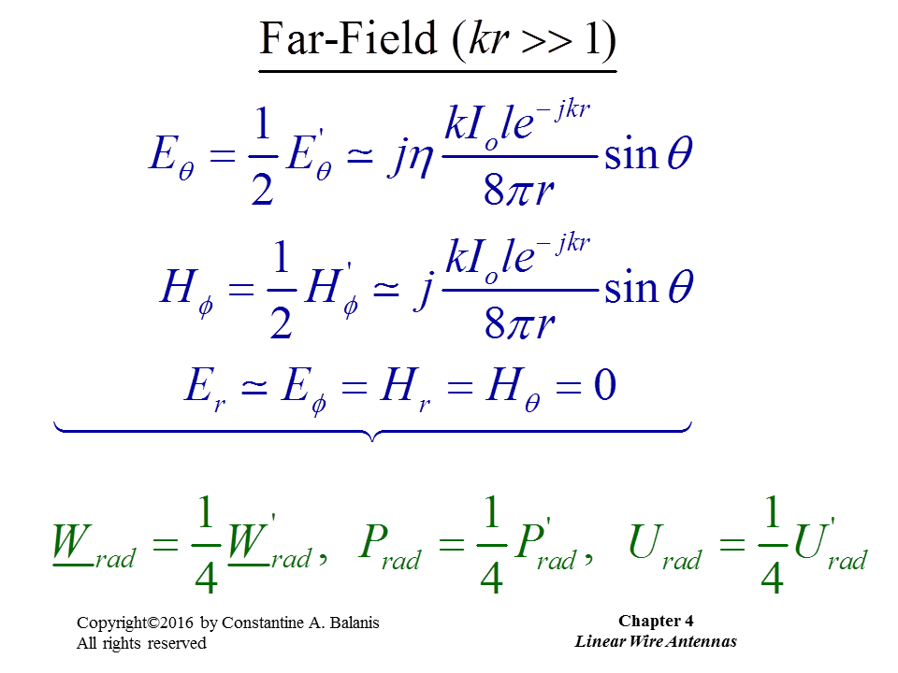

Slide 37
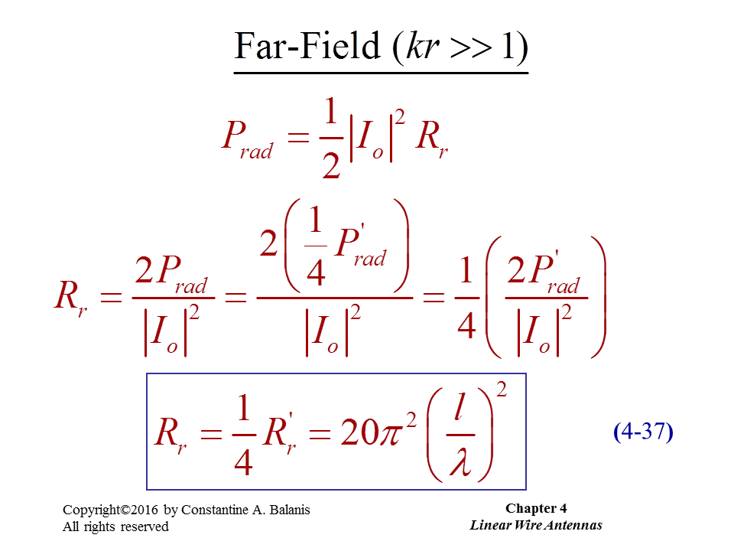

Slide 38
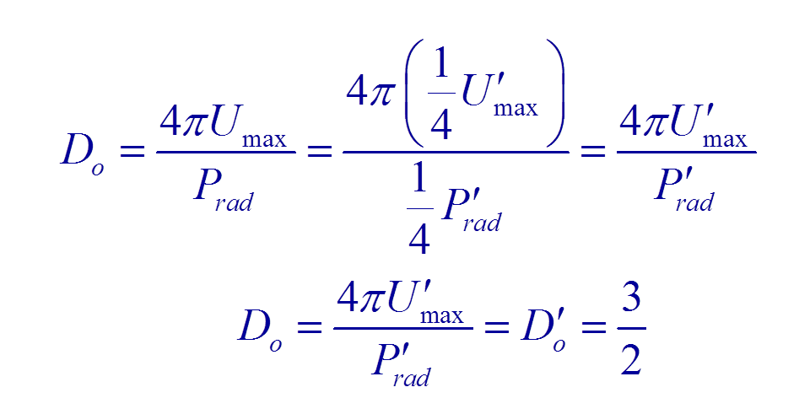

Slide 39
Far Field and Near Field

Slide 40
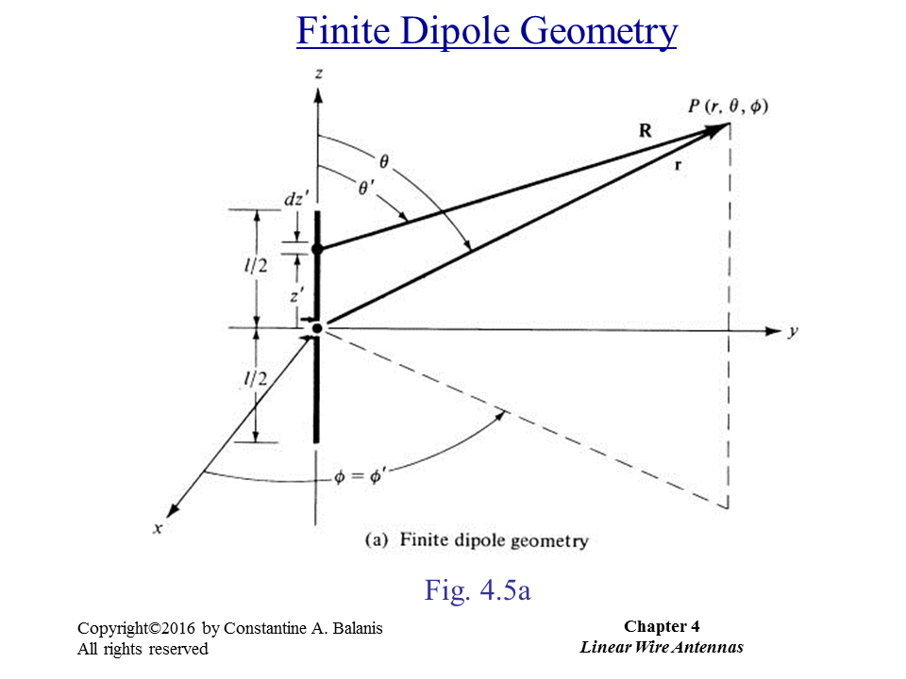

Slide 41
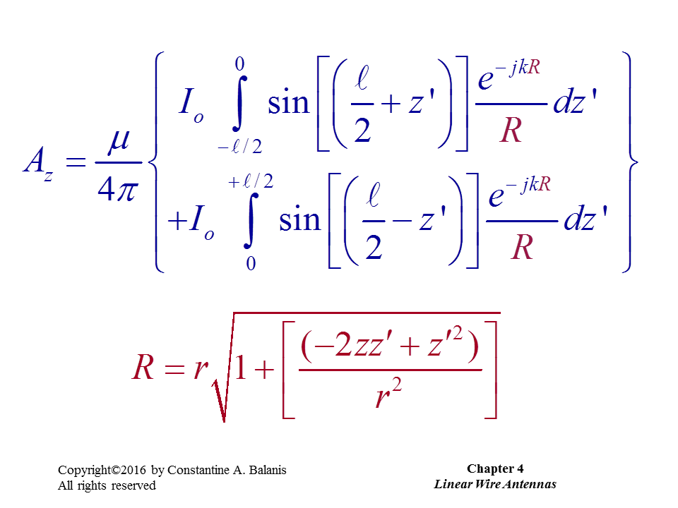

Slide 42
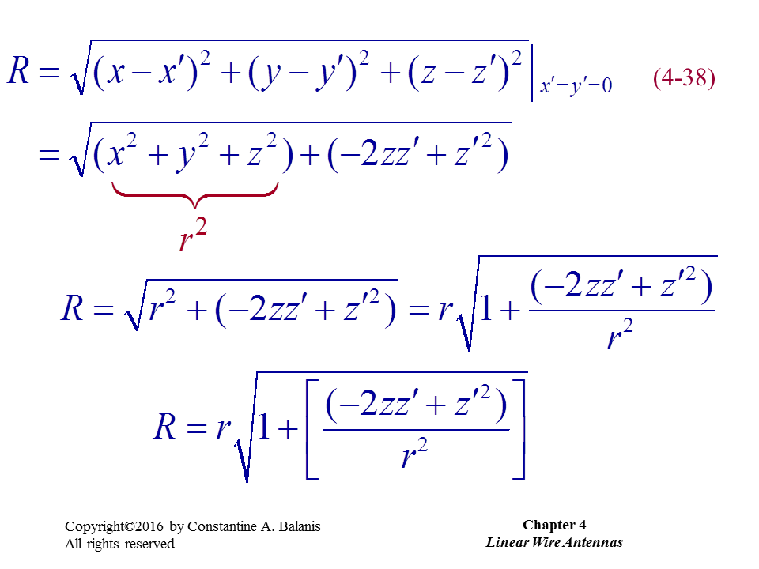

Slide 43
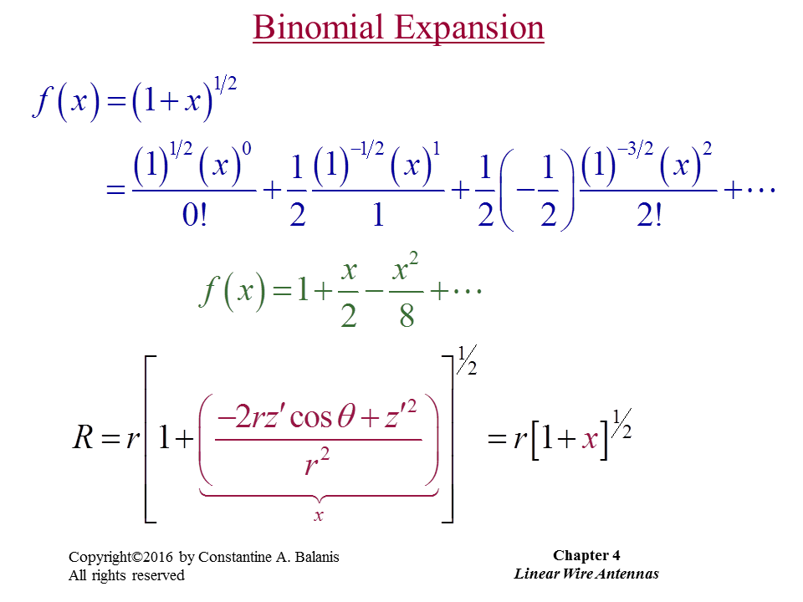

Slide 44
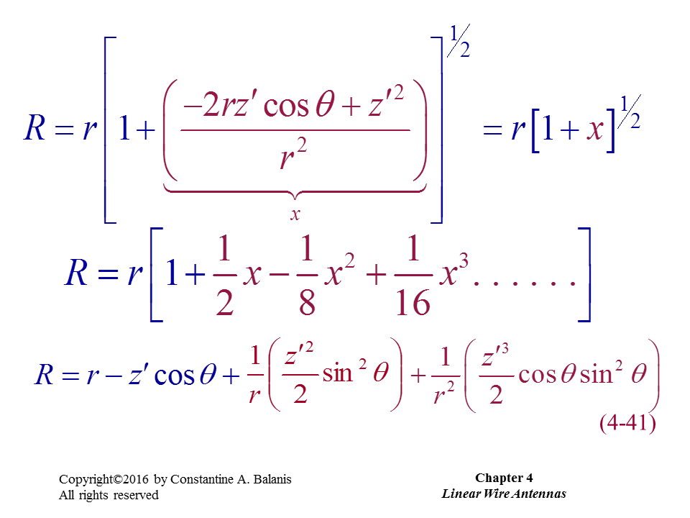

Slide 45
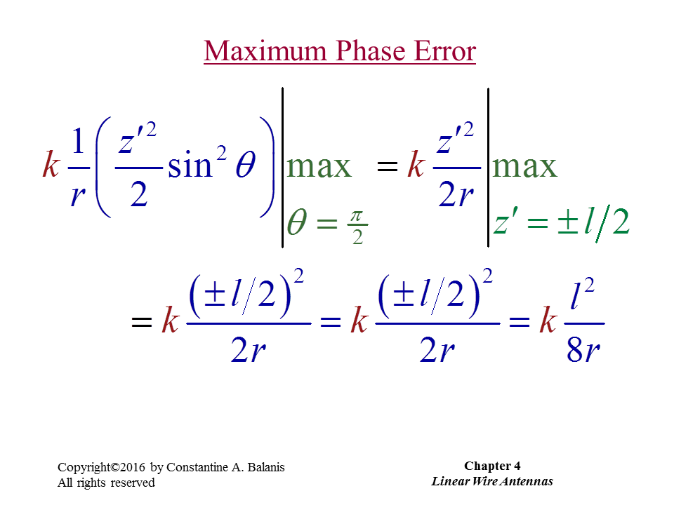

Slide 46
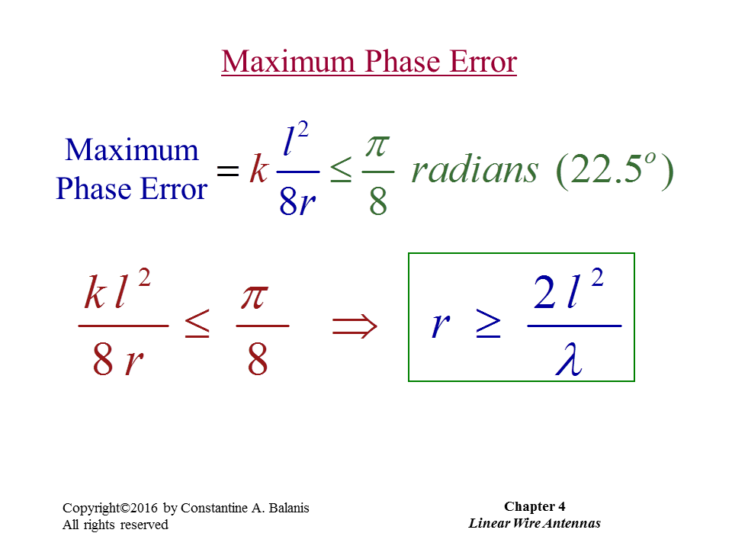

Slide 47
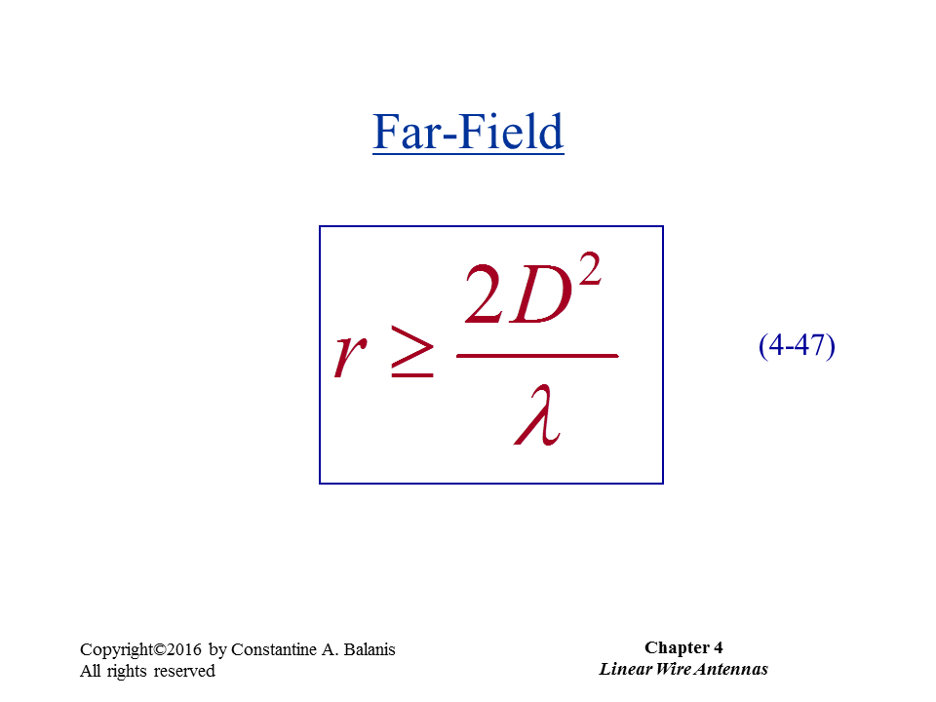

Slide 48
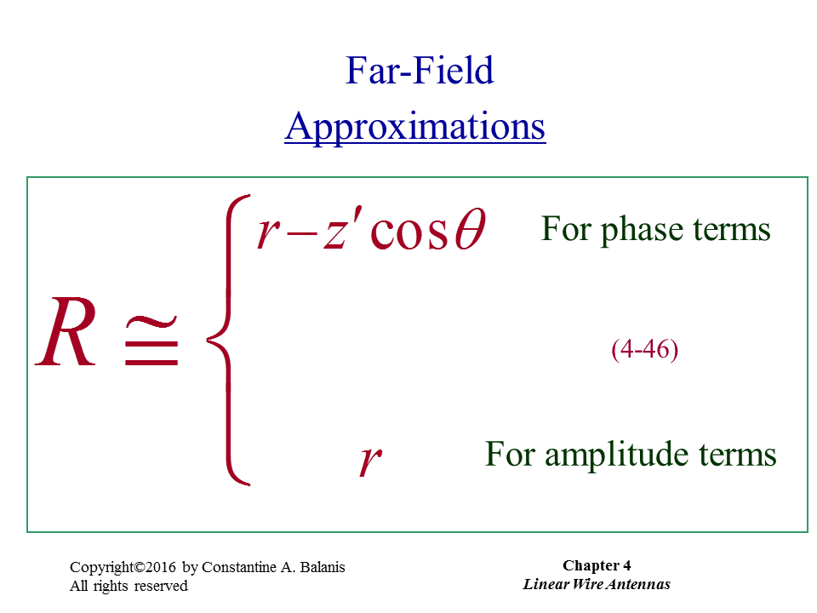

Slide 49
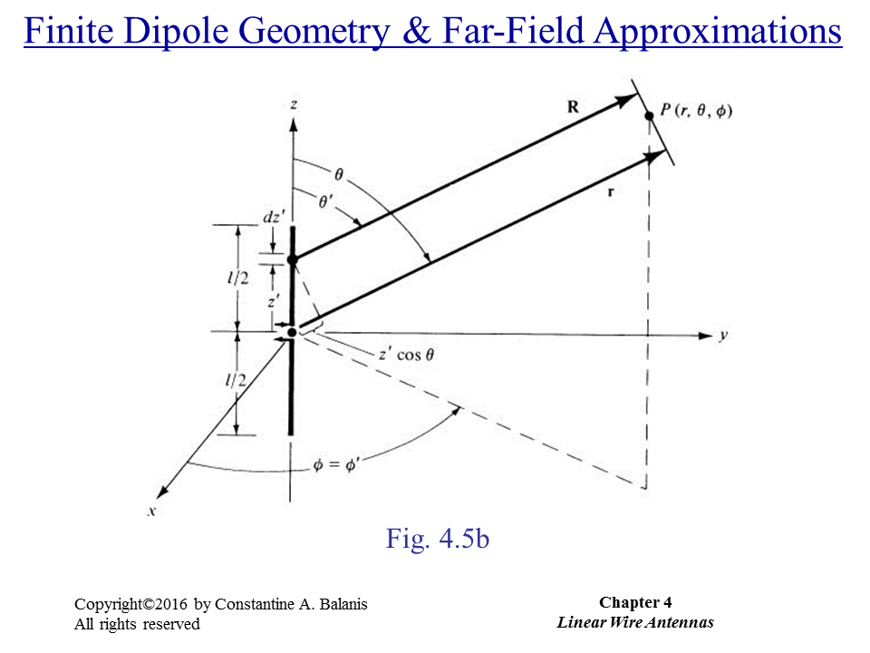

Slide 50
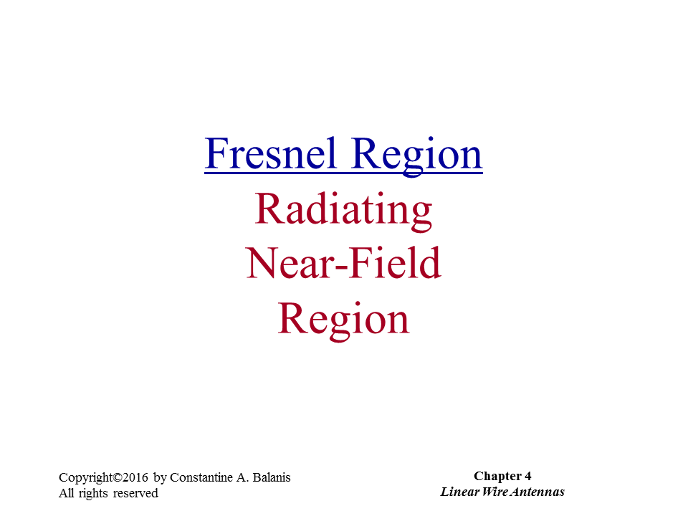

Slide 51
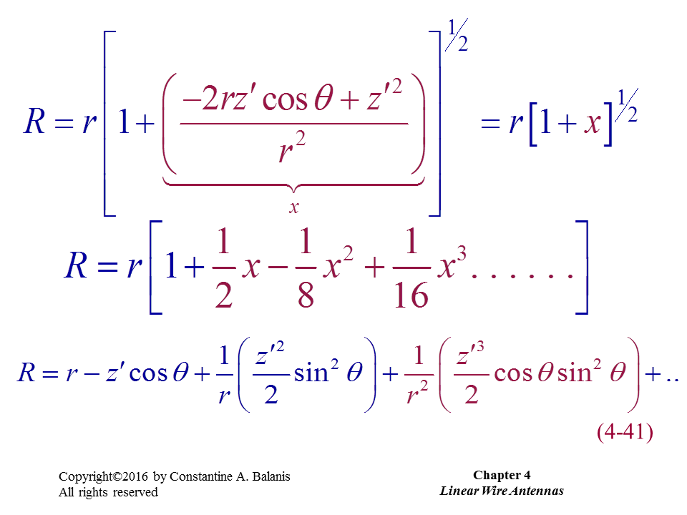

Slide 52
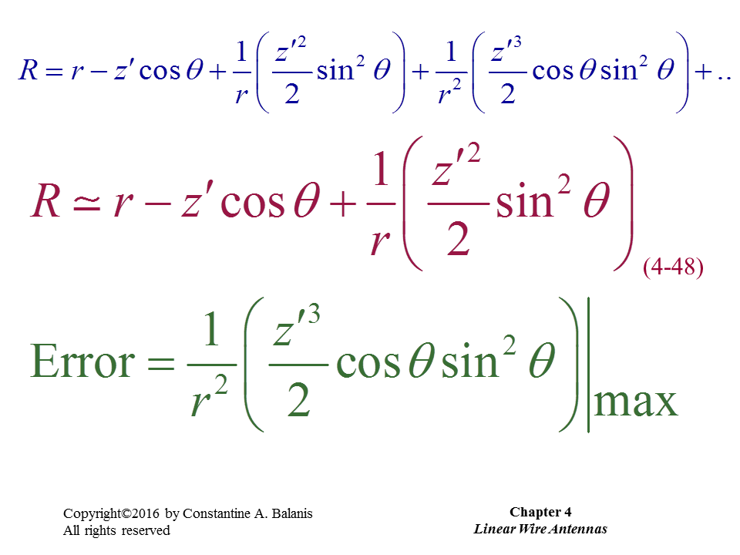

Slide 53
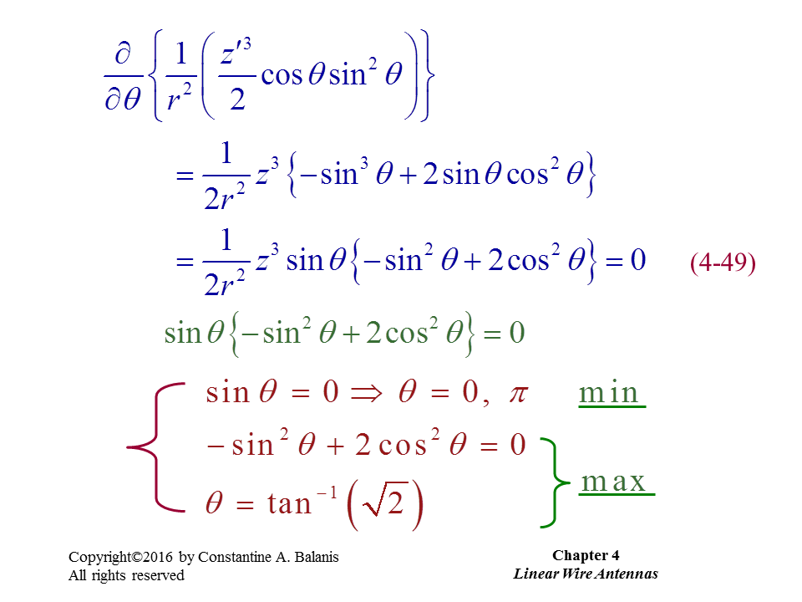

Slide 54


Slide 55



Slide 56


Slide 57


Slide 58

Finite-Length Dipole

Slide 59


Slide 60


Slide 61


Slide 62


Slide 63


Slide 64


Slide 65


Slide 66


Slide 67


Slide 68
Reprinted from Edward C. Jordan’s “Electromagnetic Waves and Radiating Systems”

Slide 69


Slide 70


Slide 71


Slide 72


Slide 73


Slide 74


Slide 75


Slide 76


Slide 77

73 Ω

Slide 78
Derivation of Effective Area

